Slide 1

SQL Data Analysis and Visualization with Power BI for FDA

Slide 2
SQL Data Analysis and Visualization with Power BI for FDA
The U.S. Food and Drug Administration (FDA) is a federal agency responsible for safeguarding public health in the United States. It oversees various areas, including food safety, pharmaceuticals, medical devices, cosmetics, tobacco, and veterinary products.
The FDA evaluates the safety and efficacy of drugs, biological products, and medical devices, conducts inspections, and enforces regulations. It also regulates food production and distribution, conducts research, provides public health education, and monitors and responds to emerging health risks.
Software/Tools:
● MySQL
● Power BI

Slide 3
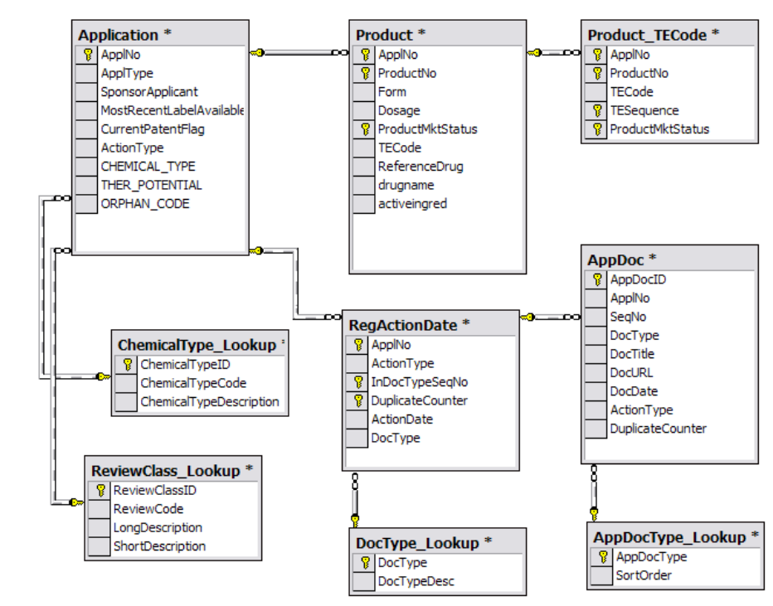
Data Schema (Draugs@FDA Dataset):

Slide 4
Project Objectives Part - 1 SQL Queries
Task 1: Identifying Approval Trends
1.1 Determine the number of drugs approved each year and provide insights into the yearly trends.
select year(actiondate) as Yearly_Approvedata, count(applno) as Approved_application from regactiondate where actiontype = "AP"group by year(actiondate);
##Insight - In 2002, the U.S. Food and Drug Administration (FDA) carried out its enforcement activities with renewed awareness, commitment, and determination to
protect the American public from the new threat of bioterrorism.
1.2 Identify the top three years that got the highest and lowest approvals, in descending and ascending order, respectively.
→select year(actiondate) as Yearly_Approvedata, count(applno) as Approved_application from regactiondate where actiontype = "AP"group by year(actiondate)order by count(applno) desclimit 3;
→select year(actiondate) as Yearly_Approvedata, count(applno) as Approved_application from regactiondate where actiontype = "AP"group by year(actiondate)order by count(applno)limit 3;

Slide 5
1.3 Explore approval trends over the years based on sponsors.
→select year (rg.actiondate) Yearly_Date, count(ap.applno) as Application_count, count(distinct(ap.sponsorapplicant))as Sponsor_count,round(count(ap.applno)/count(distinct(ap.sponsorapplicant))) as Approval_Per_Sponsorfrom application as ap inner join regactiondate as rgon ap.applno = rg.applnowhere ap.actiontype = "AP"group by year(rg.actiondate)order by year(rg.actiondate);
→select year (rg.actiondate) Yearly_Date, count(ap.applno) as Application_count, count(distinct(ap.sponsorapplicant)) as Sponsor_count,round(count(ap.applno)/count(distinct(ap.sponsorapplicant))) as Approval_Per_Sponsorfrom application as ap inner join regactiondate as rgon ap.applno = rg.applnowhere ap.actiontype = "AP"group by year(rg.actiondate)order by year(rg.actiondate)

Slide 6
1.4 Rank sponsors based on the total number of approvals they received each year between 1939 and 1960. →select year(rg.actiondate), ap.sponsorapplicant, rank() over(partition by ap.sponsorapplicant order by year(rg.actiondate) desc) as Sponser_rankfrom application as ap inner join regactiondate as rgon ap.applno = rg.applnowhere ap.actiontype = "AP" AND year(rg.actiondate)in("1939","1940","1941","1942","1943","1944","1945","1946","1947","1948","1950","1951","1952","1953","1954","1955","1956","1957","1958","1959","1960") →DENSE_RANK() OVER(PARTITION BY (SELECT YEAR(rg.actiondate) FROM regactiondate) ORDER BY (select count(ap.applno))select ap.sponsorapplicant, count(ap.applno) as No_Approvals, Dense_rank() over(order by count(ap.applno) desc) as Sponser_rankfrom application as ap inner join regactiondate as rgon ap.applno = rg.applnowhere ap.actiontype = "AP" AND year(rg.actiondate) in ("1939","1940","1941","1942","1943","1944","1945","1946","1947","1948","1950","1951","1952","1953","1954","1955","1956","1957","1958","1959","1960")group by ap.sponsorapplicant

Slide 7
2.1 Group products based on MarketingStatus. Provide meaningful insights into the segmentation patterns. →select * from product select * from application select p.productno, count(a.Applno)from application as a inner join product as p inner join regactiondate as rgon a.applno = p.applno AND a.applno = rg.applno where rg.actiontype = "AP" AND p.productmktstatus = "2“group by p.productno order by count(applno) desc select productmktstatus as Product_MKT_Status, count(distinct(productno)) as Product_categories, count(applno) as Total_Applicationfrom product group by productmktstatus select drugname DRUG_NAME, count(drugname) as No_of_Applications from product where productmktstatus = "1"group by drugname order by count(drugname) desc limit 5 select drugname, count(drugname) from product where productmktstatus = "4"group by drugname order by count(drugname) desc limit 5
Task 2: Segmentation Analysis Based on Drug MarketingStatus

Slide 8
2.2 Calculate the total number of applications for each MarketingStatus year-wise after the year 2010. → Type 1 ---------> select p.productmktstatus, count(p.applno) as Total_Applicationfrom product as p inner join application as a inner join regactiondate as rgon a.applno = rg.applno AND a.applno = p.applnowhere year(rg.actiondate) > "2011"group by p.productmktstatus Union select p.productmktstatus, count(p.applno) as Total_Applicationfrom product as p inner join application as a inner join regactiondate as rgon a.applno = rg.applno AND a.applno = p.applnowhere year(rg.actiondate) > "2012"group by p.productmktstatus union select p.productmktstatus, count(p.applno) as Total_Applicationfrom product as p inner join application as a inner join regactiondate as rgon a.applno = rg.applno AND a.applno = p.applnowhere year(rg.actiondate) > "2013"group by p.productmktstatus →Type 2 --------->select distinct(year(rg1.actiondate)) as yearly_value1, count(p1.applno) as total1from product as p1 inner join application as a1 inner join regactiondate as rg1on a1.applno = p1.applno AND a1.applno = rg1.applno where year(rg1.actiondate) > "2010" AND p1.productmktstatus = "1"group by year(rg1.actiondate)order by year(rg1.actiondate)Union select distinct(year(rg2.actiondate)) as yearly_value2, count(p2.applno) as total2 from product as p2 inner join application as a2 inner join regactiondate as rg2on a2.applno = p2.applno AND a2.applno = rg2.applno where year(rg2.actiondate) > "2010" AND p2.productmktstatus = "2"group by year(rg2.actiondate)order by year(rg2.actiondate)

Slide 9
2.3 Identify the top MarketingStatus with the maximum number of applications and analyze its trend over time. → select distinct(year(rg1.actiondate)) as FY_Year, count(p1.applno) as Total_application, dense_rank() over (order by count(p1.applno) desc) RANK_HIGH_LOW_COUNT from product as p1 inner join application as a1 inner join regactiondate as rg1on a1.applno = p1.applno AND a1.applno = rg1.applno where p1.productmktstatus = (select productmktstatus from product group by productmktstatus order by count(applno) desc limit 1)group by year(rg1.actiondate)

Slide 10
Task 3: Analyzing Products
3.1 Categorize Products by dosage form and analyze their distribution.
select form, dosage, count(ProductNo) as ProductCountfrom productgroup by dosage, formorder by ProductCount desc
3.2 Calculate the total number of approvals for each dosage form and identify the most successful forms.
select p.FORM, p.DOSAGE, count(p.applno) TOTAL_APPROVALfrom product as p inner join application as aon p.applno=a.applnowhere actiontype = "AP"group by p.form, p.dosageorder by count(p.applno) desc
3.3 Investigate yearly trends related to successful forms.
select * from productselect * from regactiondate select year(rg.actiondate) as "approval_year",p.productno, p.form, count(rg.applno) as "total_approvalno"from product as p inner join regactiondate as rg on p.applno = rg.applno group by p.form, p.productno, year(rg.actiondate)order by Total_Approvalno desc;

Slide 11
Task 4: Exploring Therapeutic Classes and Approval Trends
4.1 Analyse drug approvals based on therapeutic evaluation code (TE_Code).
SELECT p.tecode, COUNT(a.ApplNo) AS "DrugApprovals"FROM product AS p INNER JOIN application AS a ON p.ApplNo = a.ApplNo WHERE ActionType = "AP"GROUP BY p.tecode ORDER BY DrugApprovals DESC;
4.2 Determine the therapeutic evaluation code (TE_Code) with the highest number of Approvals in each year.
select year(r.actiondate), p.tecode, count(a.applno) as "Total_approval"from regactiondate as r inner join application as a inner join product as pon a.applno = r.applno AND a.applno = p.applnowhere a.actiontype = "AP"group by year(r.actiondate), p.tecodeorder by Total_approval descselect * from product_tecodeselect * from productselect * from regactiondate from product_tecode as PT inner join regactiondate as r

Slide 12
Part - 2 Power BI Visualizations :

Slide 13
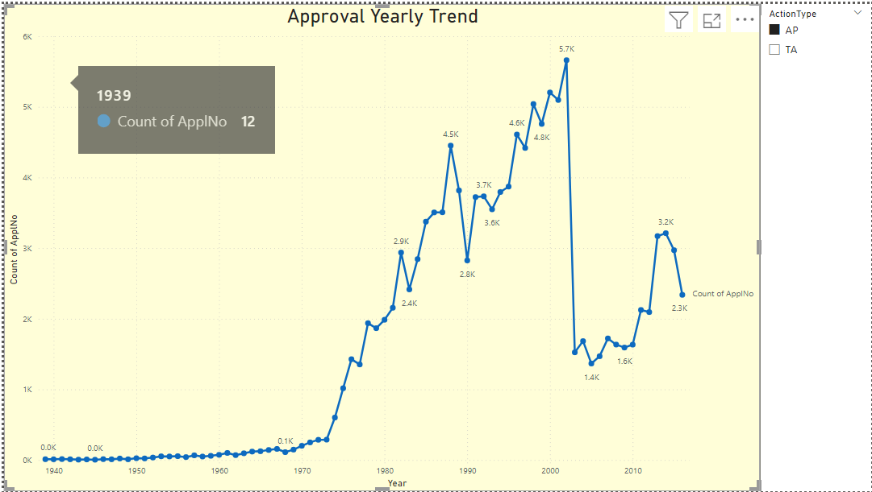
Visualize the yearly approval trends of drugs. Highlight any significant patterns and/or fluctuations

Slide 14
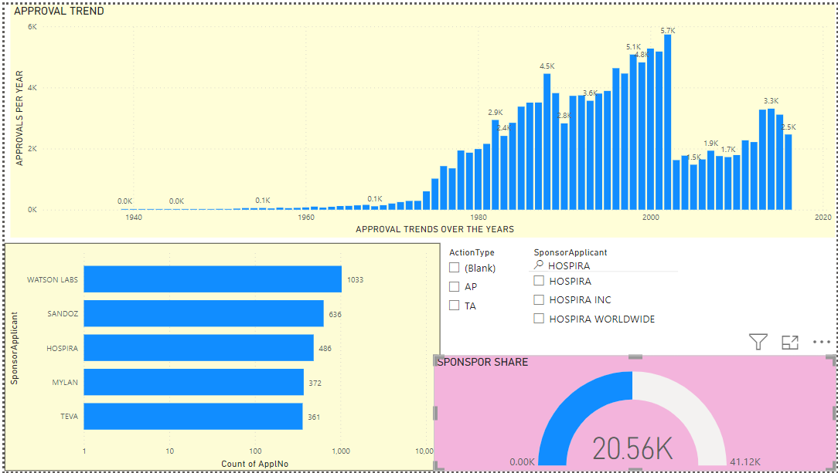
Explore approval trends over the years based on different sponsors. Uncover patterns and changes in approval rates among sponsors

Slide 15
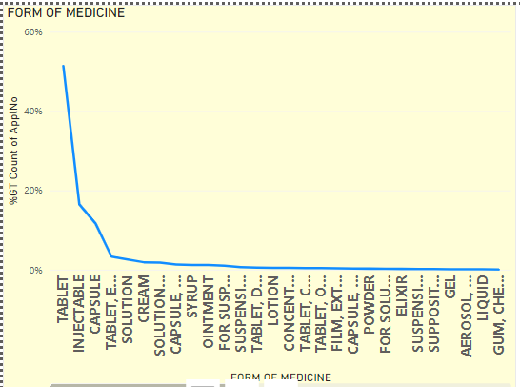
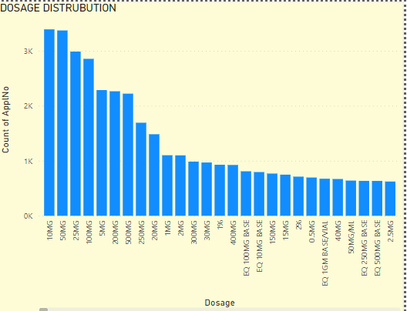
Visualize the segmentation of products based on Marketing Status
← TYPE OF MEDICINE DISTRIBUTION
DOSAGE DISTRIBUTION →

Slide 16
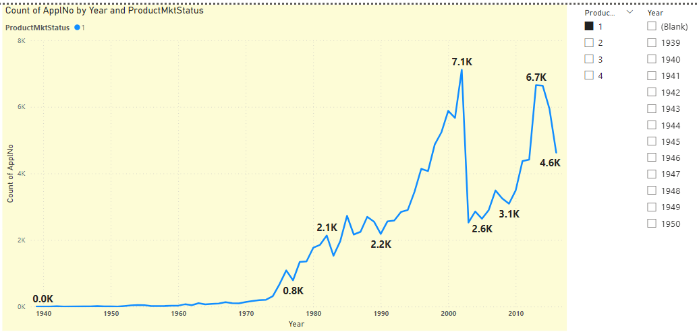
Show the total number of applications for each MarketingStatus. Enable users to filter by years and MarketingStatus for detailed analysis

Slide 17
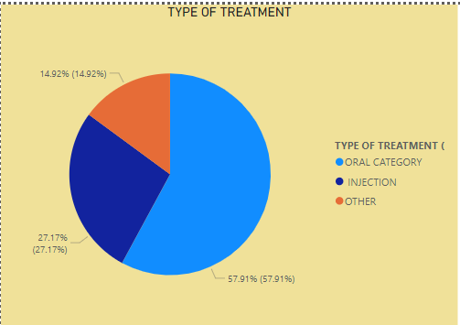
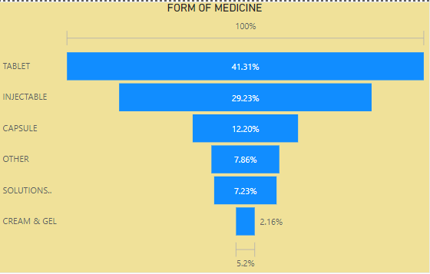
Analyze the grouping of drugs by dosage form. Visualize the distribution of approvals across different forms. Identify the most successful dosage form
← TYPE OF TRATMENT
FORM OF MEDICINE →

Slide 18
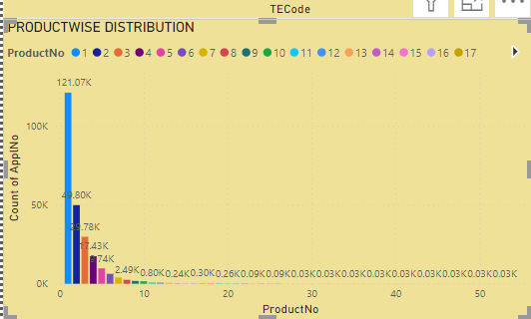
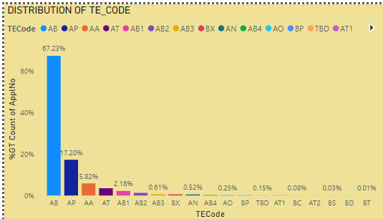
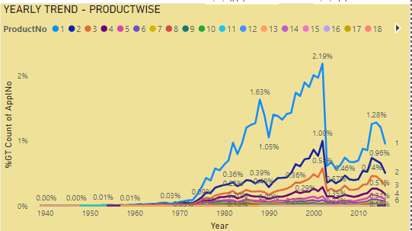
Visualize drug approvals based on therapeutic classes. Identify classes with the highest number of approvals.
PRODUCTWISE DISTRIBUTION
TE_CODEWISE DISTRIBUTION
PRODUCTWISE YEARLY TREND

